Slide 1
TNSDC-Gen AI Project
THANES M
2021503712
CT Dept. MIT, Anna University
4/29/2024 Annual Review

Slide 2
PROJECT TITLE
Topic : Crime Analysis and Prediction with Machine Learning
4/29/2024 Annual Review

Slide 3


AGENDA
Data collection, preprocessing, and feature engineering
Model selection, training, and evaluation
Interpretation of results
Deployment and integration
Future considerations for improvement and scalability
3/21/2024 Annual Review
4/29/2024 Annual Review

Slide 4

PROBLEM STATEMENT
Analyze the impact of modern technologies on increasing burglary, arson, and murder rates, based on Crime Record Bureau reports.
Investigate swiftly identifying criminals and crime hotspots to aid law enforcement prevention strategies.
Examine factors influencing crime prediction accuracy, including criminal intelligence, security measures, and geographical location.
Evaluate crime analysis methods for pattern detection and actionable insights generation for law enforcement.
4/29/2024 Annual Review

Slide 5

PROJECT OVERVIEW
Data Preprocessing :
Cleaning the dataset by handling missing values and outliers.
Encoding categorical variables for model compatibility.
Feature selection to identify relevant attributes for crime prediction.
Scaling numerical features to ensure uniformity in model training.
K-means Clustering :
Utilizing K-means clustering to identify patterns and groupings within the dataset.
Clustering crime data based on spatial attributes such as latitude and longitude.
Analyzing clusters to understand high-crime areas and temporal trends.
4/29/2024 Annual Review

Slide 6
PROJECT OVERVIEW
Kernel SVM :
Implementing Kernel SVM for crime prediction, considering its ability to handle nonlinear relationships.
Training the SVM model using labeled crime data, with features such as location, time, and crime type.
Evaluating the SVM model's performance using appropriate metrics like accuracy, precision, and recall.
Visualization :
Creating graphical representations to visualize crime trends over time and space.
Plotting crime density maps to identify hotspots and prioritize resource allocation.
Generating temporal graphs to depict variations in crime rates by time of day, month, or year.
4/29/2024 Annual Review

Slide 7

WHO ARE THE END USERS?
Law Enforcement Personnel
Government Officials
Crime Analysts
Community Policing Teams
Researchers
4/29/2024 Annual Review

Slide 8

MY SOLUTION AND ITS VALUE PROPOSITION
SOLUTION :
Develop a machine learning model using artificial neural networks (ANNs),Support Vector Machine Algorithm to predict crime analysis and prediction based on dataset.
Utilize Python programming language with libraries such as TensorFlow or PyTorch for ANN implementation.
Use Colab Notebook for interactive development and documentation of the project.
4/29/2024 Annual Review

Slide 9
MY SOLUTION AND ITS VALUE PROPOSITION
VALUE PROPOSITION :
Develop a machine learning model for predicting crime trends based on diverse data sources such as demographics, socioeconomic factors, and historical crime data.
Impact : Empowers law enforcement agencies, policymakers, and community leaders with actionable insights for proactive crime prevention, resource allocation, and policy formulation.
Benefits : Harnessing advanced algorithms to optimize law enforcement strategies, enhance public safety, and reduce crime rates, ultimately fostering safer communities and improving quality of life.
4/29/2024 Annual Review

Slide 10

THE WOW IN MY SOLUTION
The "WOW" factor in our solution lies in its transformative impact on crime prevention strategies and law enforcement operations. By leveraging cutting-edge machine learning techniques, our solution offers:
Comprehensive Approach : Our project adopts a holistic approach to crime analysis and prediction, integrating diverse methodologies including time series analysis, machine learning algorithms, and interpretable AI techniques. This ensures a thorough comprehension of crime patterns, trends, and influential factors.
Practical Application : Through deployment as a user-friendly web application using Flask, our solution offers law enforcement agencies and policymakers convenient access to actionable insights and predictive analytics. This empowers them to implement targeted crime prevention strategies, allocate resources efficiently, and enhance public safety effectively.
3/21/2024 Annual Review

Slide 11
THE WOW IN MY SOLUTION
Insightful Visualizations: The use of visualizations such as the Kaplan-Meier curve, log-rank test plots, and values in the Flask app enhances the user experience and facilitates better decision-making.
Focus on Lifetime Value: Calculating the expected lifetime value of customers adds a valuable dimension to the analysis, helping businesses prioritize their retention efforts based on the potential value of each customer.
Business Impact: The ultimate "wow" factor lies in the potential business impact of your solution, which can lead to significant cost savings through reduced churn rates and increased customer retention and loyalty.
3/21/2024 Annual Review

Slide 12
MODELLING
Data Preprocessing :
Cleaning the dataset by handling missing values and outliers.
Encoding categorical variables for model compatibility.
Feature selection to identify relevant attributes for crime prediction.
Scaling numerical features to ensure uniformity in model training.
K-means Clustering :
Utilizing K-means clustering to identify patterns and groupings within the dataset.
Clustering crime data based on spatial attributes such as latitude and longitude.
Analyzing clusters to understand high-crime areas and temporal trends.
4/29/2024 Annual Review

Slide 13
MODELLING
3.Kernel SVM :
Implementing Kernel SVM for crime prediction, considering its ability to handle nonlinear relationships.
Training the SVM model using labeled crime data, with features such as location, time, and crime type.
Evaluating the SVM model's performance using appropriate metrics like accuracy, precision, and recall.
4.Visualization :
Creating graphical representations to visualize crime trends over time and space.
Plotting crime density maps to identify hotspots and prioritize resource allocation.
Generating temporal graphs to depict variations in crime rates by time of day, month, or year.
4/29/2024 Annual Review

Slide 14
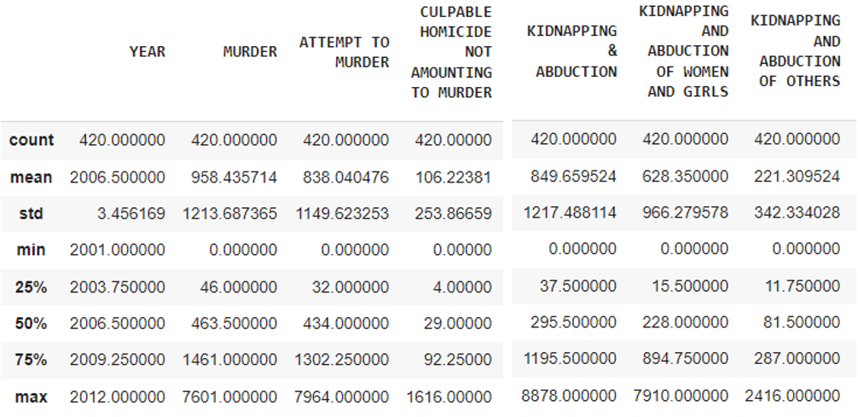
RESULTS
# Predicting Test Set
4/29/2024 Annual Review

Slide 15
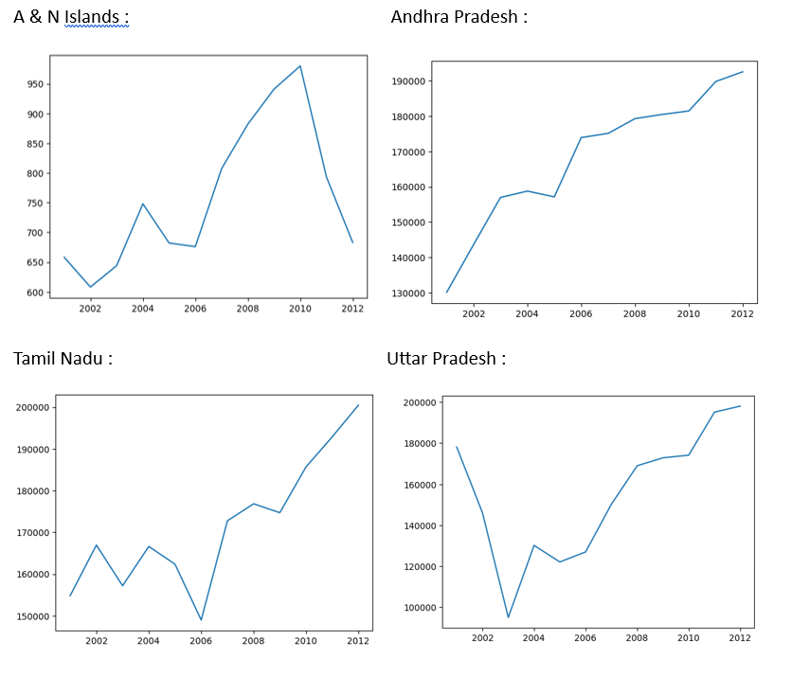
GRAPHS
4/29/2024 Annual Review

